Slide 1
ENTREPRENEURSHIP
Lecture No: 10
Resource Person:
Malik Jawad Saboor
Assistant Professor
Department of Management Sciences
COMSATS Institute of Information Technology
Islamabad.

Slide 2

Previous Lecture Review
Creativity Techniques
Brainstorming
Mind Mapping
Rapid Prototyping
Mix n Match
Attribute Listing Chart

Slide 3

Objectives
Distinguish the different forms of Innovation
Differentiate between the different types of innovation

Slide 4


INNOVATION
Making Sense of Innovation
Categorization based upon
Form of Innovation (Application)
Degree of Novelty

Slide 5
FORMS OF INNOVATION
3 Principles Applications of Innovation
Product Innovation
Service Innovation
Process Innovation

Slide 6
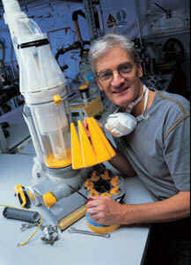
PRODUCT INNOVATION
Consumer Products- Most obvious Application
Example:
Dyson- Dual Cyclone Technology
IPhone
Helps Persuade Customers in buying decision
Ansoff matrix has a business strategy called New Product Development
Equally applicable to Industrial Products

Slide 7



SERVICE INNOVATION
New Service Applications
Do not attract as much as Product Innovations
Take form of a new way of providing existing service with new Business Model
Example ‘Direct Line’ Telephone Insurance Business
Example ‘Ryan Air’

Slide 8


SERVICE INNOVATION
Completely New Services
Example: lastminute.com
Example: ebay.com

Slide 9
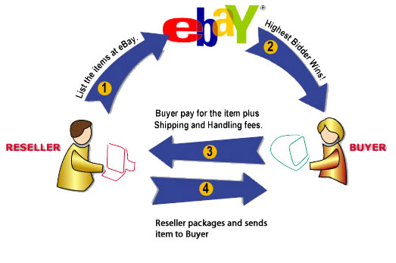
SERVICE INNOVATION

Slide 10

PROCESS INNOVATION
Bigger impact on Society
Sometimes least visible
Example: Alistair’s Float Glass Manufacturing Process
Example: B2B E-Commerce
B2C E-Commerce

Slide 11
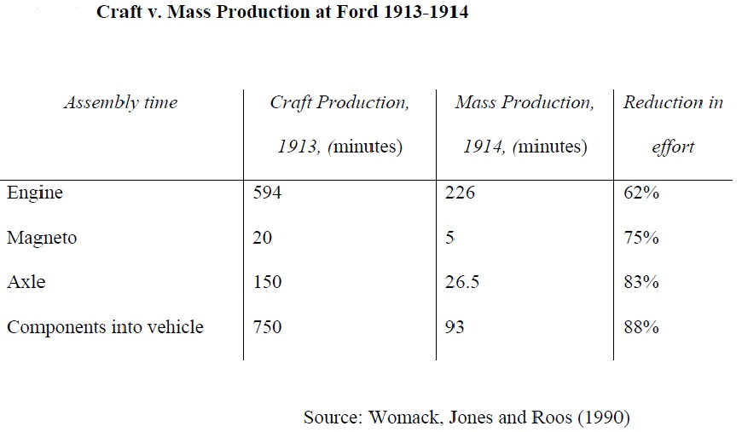
PROCESS INNOVATION

Slide 12
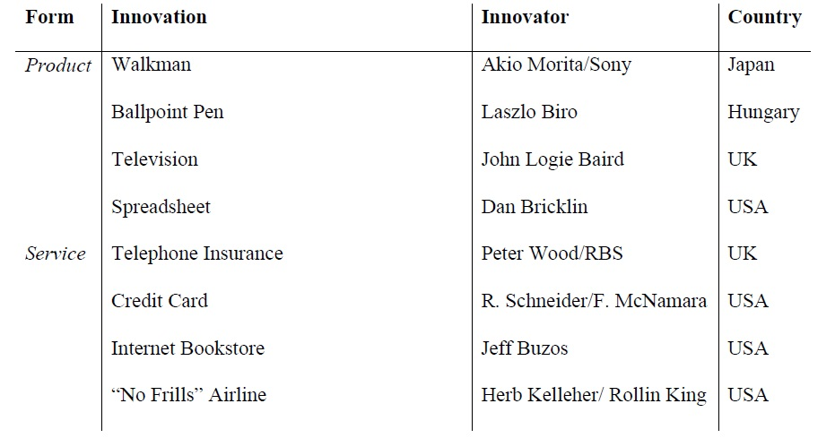
Forms of Innovation-Examples

Slide 13
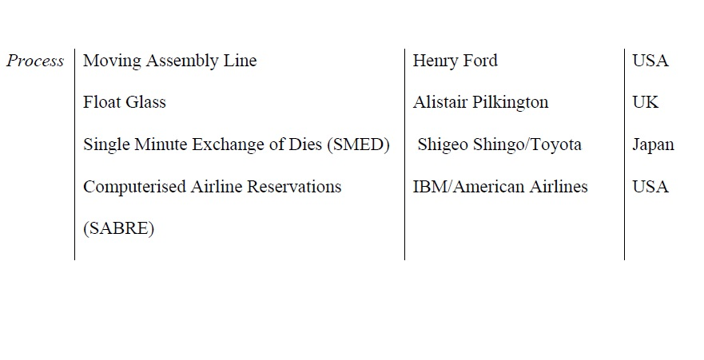



Forms of Innovation-Examples

Slide 14
TYPES OF INNOVATION
Henderson & Clarke’s Innovation Framework (1990)
Applicable to Products, Services and Process
Recognizes that Products are systems
Systems are made up of Components
Example: Pen
Components: Knib, Ink Storage, Stem, Cover, Ink
System: Interaction of Components

Slide 15
TYPES OF INNOVATION
Component Knowledge (CORE DESIGN CONCEPTS)
Knowledge of Components that Perform Well Defined Function within Broader System
System Knowledge (ARCHITECTURAL KNOWLEDGE)
The way components are integrated and linked together

Slide 16
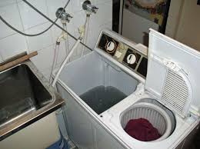
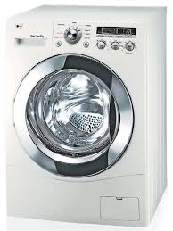
TYPES OF INNOVATION
Example: Washing Machine
Components : Motor, Pump, Drum,
Programmer, Chassis, Door and Body
System : the way in which the system is configured
Incremental Innovation: Change in Speed
20 years ago 1000 rpm; Today 1600 rpm
Architectural Innovation:
Twin Tubs Machine to Automatic Washing Machine with Spinner and Washer in one Drum

Slide 17
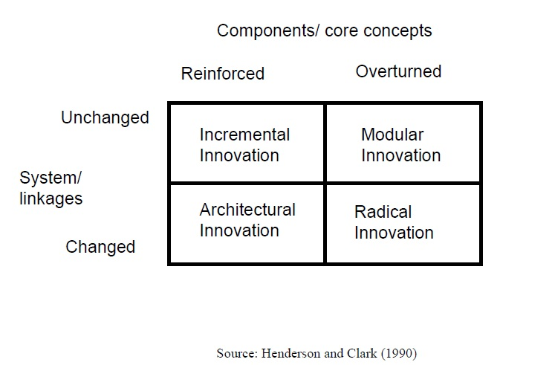
TYPES OF INNOVATION

Slide 18
TYPES OF INNOVATION
Incremental Innovation
refines and improves an existing design, through
improvements in the components.
Components are not Radically Altered
Result of Improvements in Knowledge and Materials

Slide 19
TYPES OF INNOVATION
Radical Innovation
Establishes a new dominant design, and hence a new set of core design concepts embodied in components that are linked together in a new architecture.
Often associated with the introduction of a new technology

Slide 20
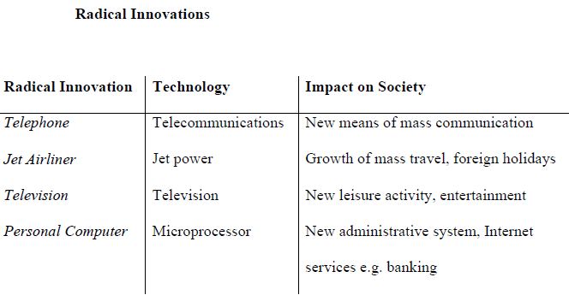
TYPES OF INNOVATION

Slide 21
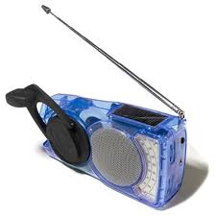
TYPES OF INNOVATION
Modular Innovation
uses the architecture of existing system of an established product, but employs new components with different design concepts.
impact is usually less dramatic than radical innovation.
Example: Clockwork Radio
Used in areas facing power shortages
In Developed Countries by Hikers

Slide 22
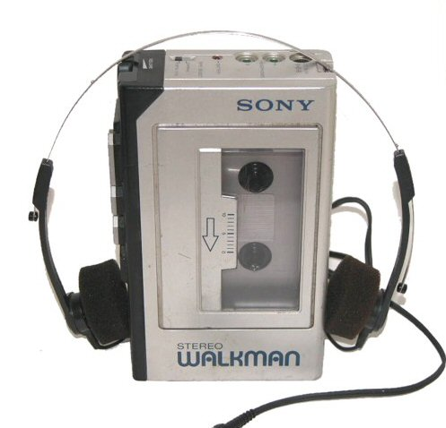
TYPES OF INNOVATION
Architectural Innovation
The reconfiguration of an established system to link together existing components in a new way.
Manufacturers take the opportunity to refine and improve some components but changes are minor
Example: Sony Walkman

Slide 23
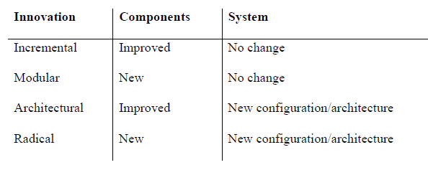
TYPES OF INNOVATION

Slide 24

Lecture Review
Distinguish the different forms of Innovation
Differentiate between the different types of innovation

